Slide 1



^{An Introduction} to Principal Component Analysis
^{Oscar Rondon}
^{October 2018}

Slide 2


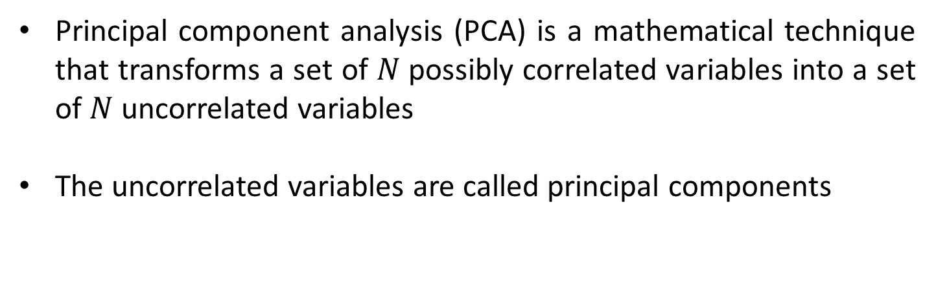
Principal component analysis (PCA) is a mathematical technique that transforms a set of $N$possibly correlated variables into a set of $N$ uncorrelated variables
The uncorrelated variables are called principal components
$$X_{1},X_{2}, ⋯,X_{N}$$
$$Y_{1},Y_{2}, ⋯,Y_{N}$$
Correlated variables
Principal components
The input variables should be linearly correlated

Slide 3
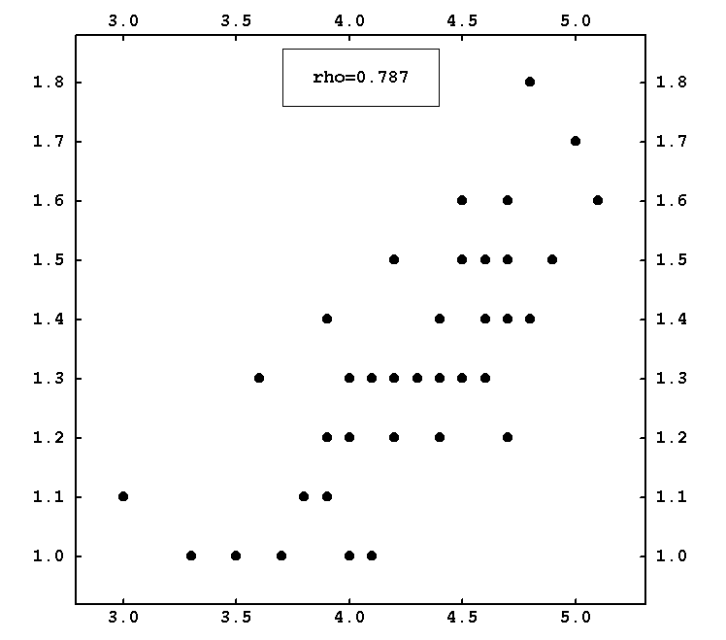
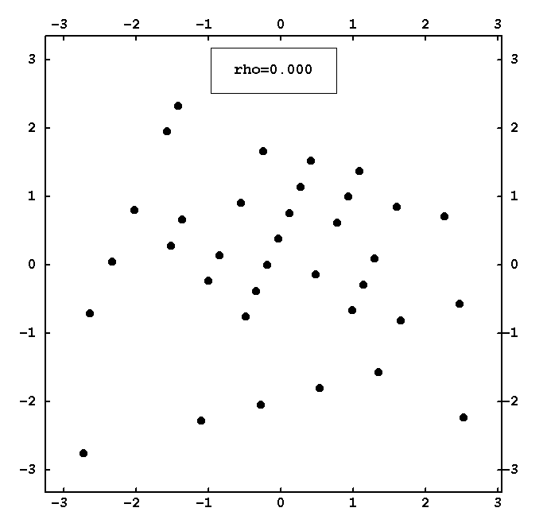




$$X_{2}$$
$$X_{1}$$
$$Y_{2}$$
Note that PCA variables have different values compared to the input variables
$$Y_{1}$$

Slide 4
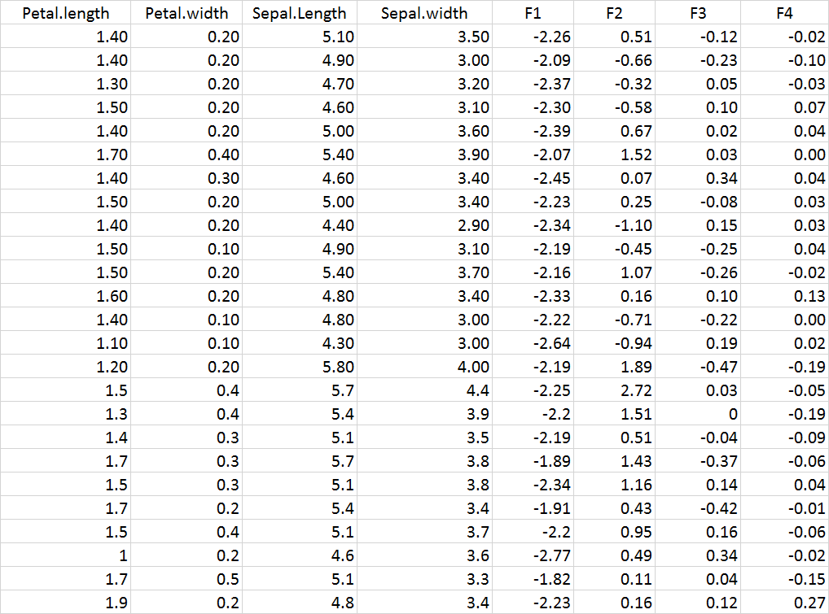
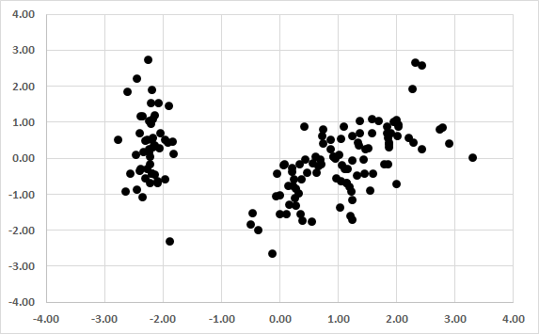
Excel table with input and PCA variables

Slide 5
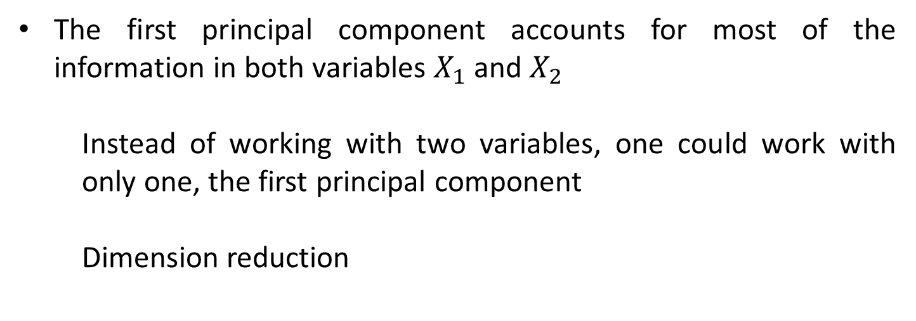
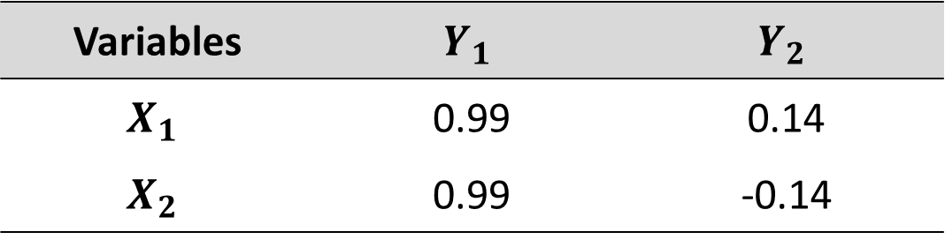
Interpretation of PCA variables is usually carried out by analysing the correlation with the input variables
Variables | $$Y_{1}$$ | $$Y_{2}$$
$$X_{1}$$ | 0.99 | 0.14
$$X_{2}$$ | 0.99 | -0.14
The first principal component accounts for most of the information in both variables $X_{1}$ and $X_{2}$
Instead of working with two variables, one could work with only one, the first principal component
Dimension reduction

Slide 6
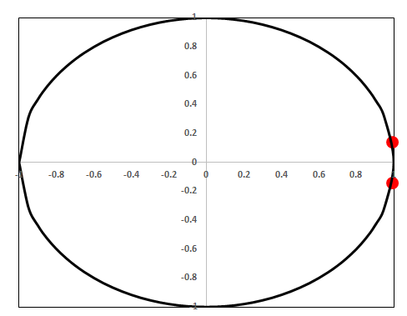
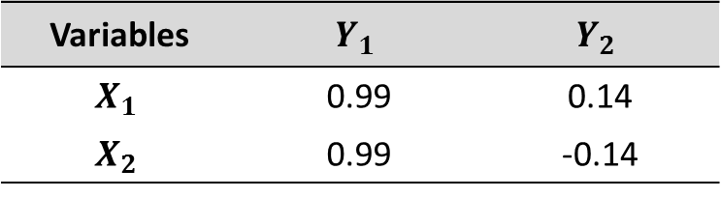
In practice, the circle of correlation is commonly used when several variable are being analysed
Variables | $$Y_{1}$$ | $$Y_{2}$$
$$X_{1}$$ | 0.99 | 0.14
$$X_{2}$$ | 0.99 | -0.14
Factor loadings

Slide 7
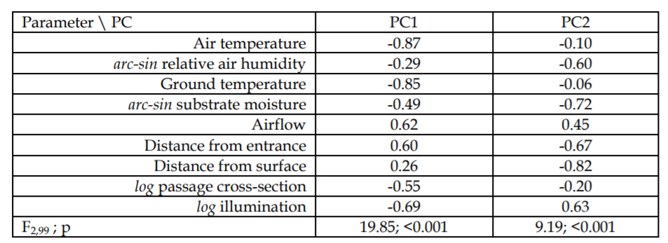
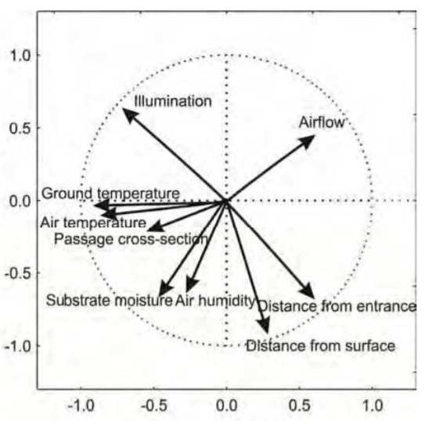
Example: Environmental data with nine input variables
What can we conclude from the circle of correlation?

Slide 8
PCA Theory – A Gentle Introduction
^{Oscar Rondon}
^{October 2018}

Slide 9
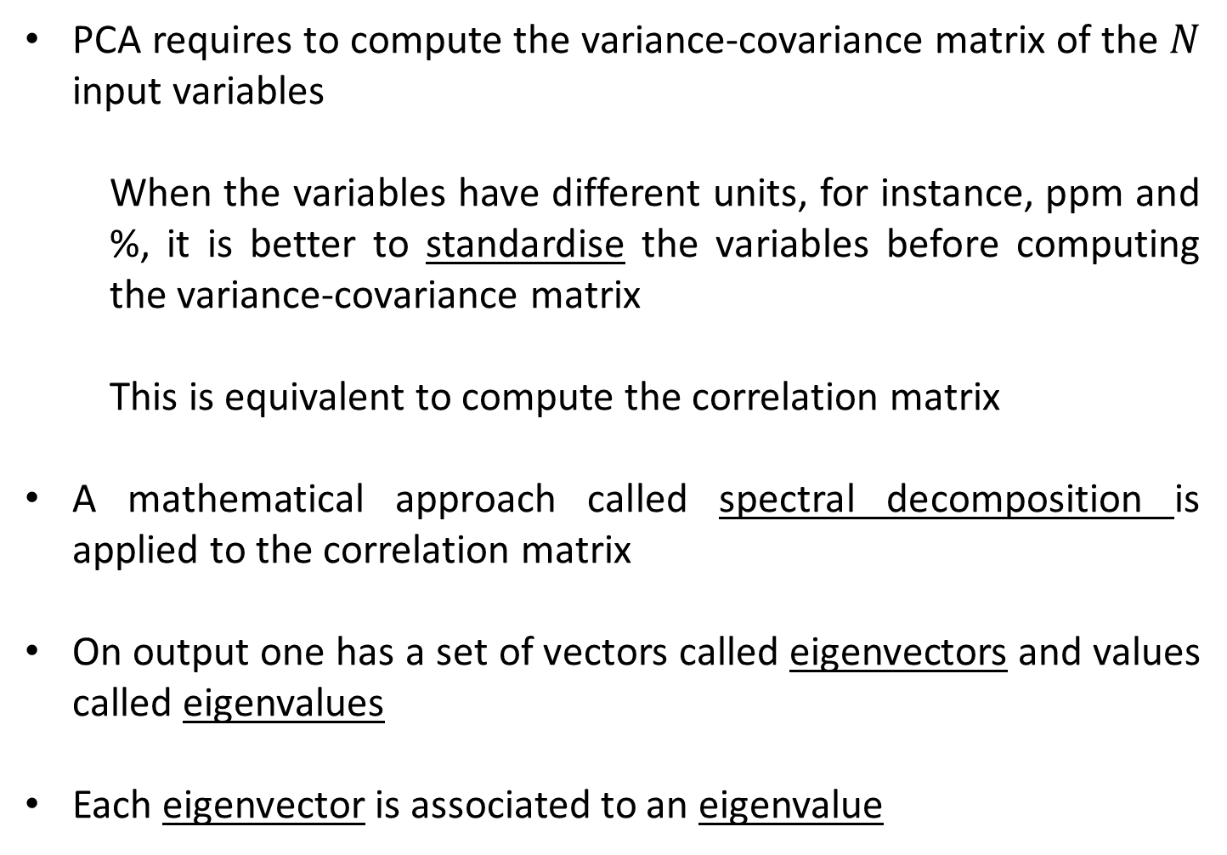
PCA requires to compute the variance-covariance matrix of the $N$ input variables
When the variables have different units, for instance, ppm and %, it is better to standardise the variables before computing the variance-covariance matrix
This is equivalent to compute the correlation matrix
A mathematical approach called spectral decomposition is applied to the correlation matrix
On output one has a set of vectors called eigenvectors and values called eigenvalues
Each eigenvector is associated to an eigenvalue

Slide 10
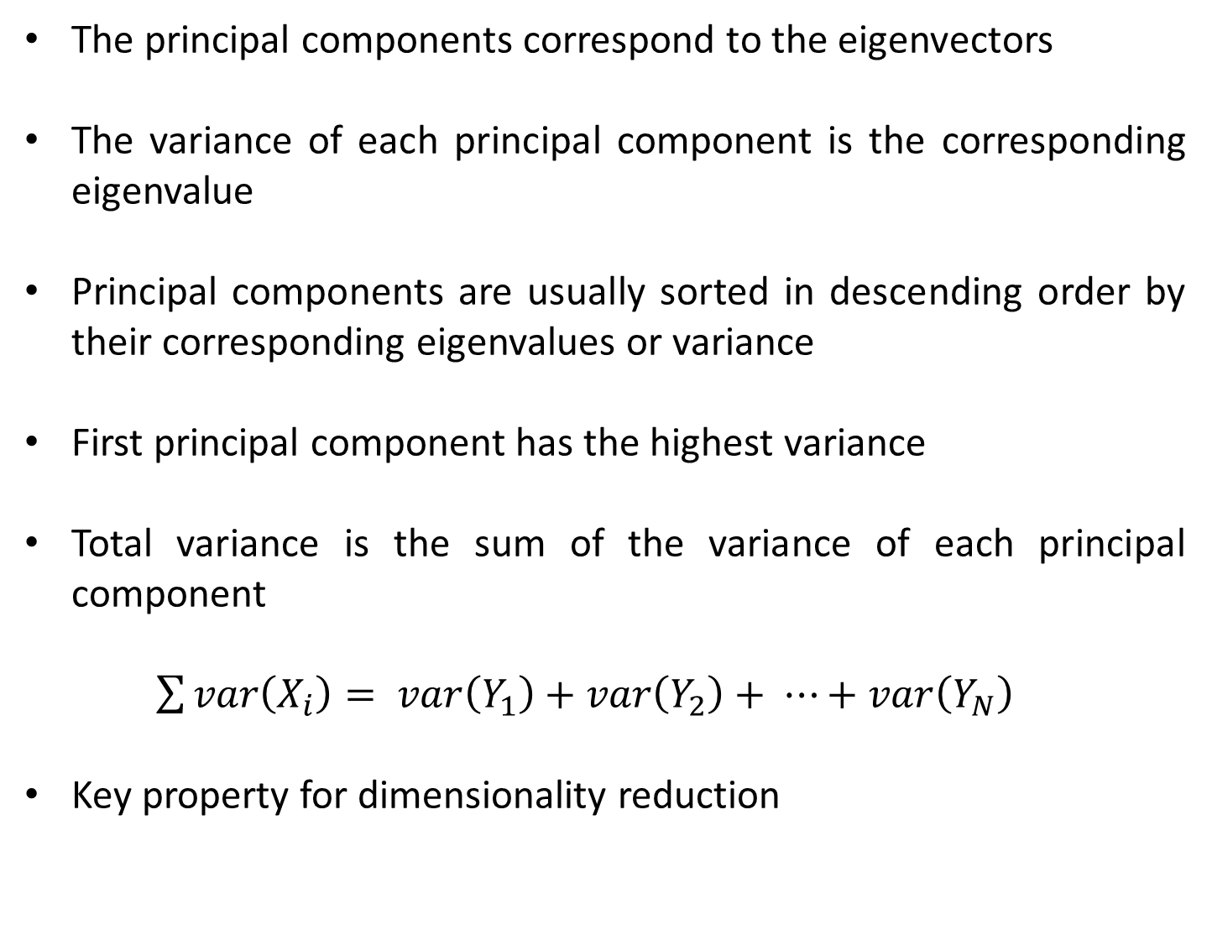
The principal components correspond to the eigenvectors
The variance of each principal component is the corresponding eigenvalue
Principal components are usually sorted in descending order by their corresponding eigenvalues or variance
First principal component has the highest variance
Total variance is the sum of the variance of each principal component
$\sum{var\left(X_{i}\right)}= var\left(Y_{1}\right)+var\left(Y_{2}\right)+ ⋯+var\left(Y_{N}\right)$
Key property for dimensionality reduction

Slide 11
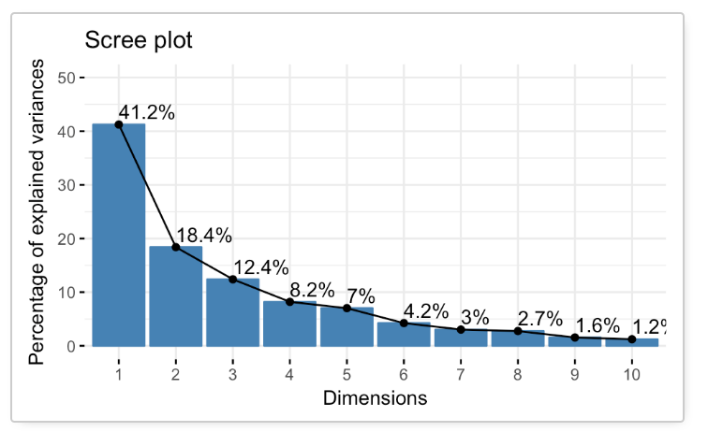
How to choose the number of principal components to retain?
The scree plot shows the fraction of the total variance in the data that is explained by each principal component

